Slide 1
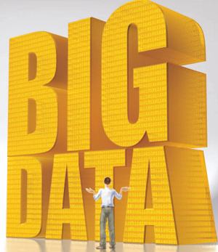
What is Big Data?
Refers to datasets whose size is beyond the ability of typical databases software tools to capture, store, manage and analyze.
Big data refers to our ability to collect, integrate and
analyze the vast amounts of data we are
now generating in the world and create
insights that will lead to value creation.
Notes:
1

Slide 2
Cost and Quantity of Data Heading in Opposite Directions
$600 = Cost to buy a disk drive that can contain all of the world’s music
30 billion pieces of content shared on Facebook each month
$600 billion potential annual consumer surplus from using personal location data globally
60% potential increase in retailers’ operating margins possible with big data
15 of 17 sectors in US have more data stored per company than US Library of Congress
McKinsley Global Institute. “Big Data: The next frontier for innovation, competition, and productivity.” June 2011.
Notes:
2

Slide 3
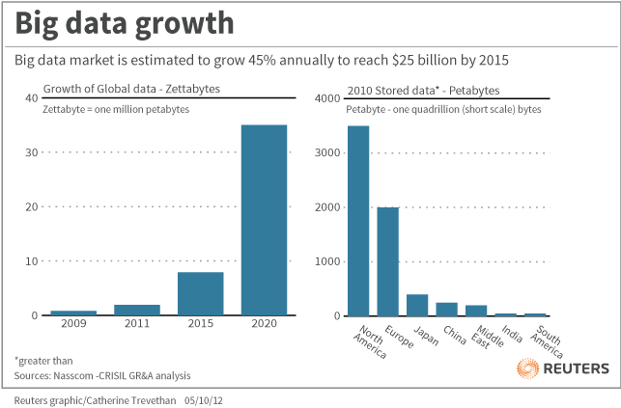
Notes:
3

Slide 4
Big Data Creates Value in Several Ways
Creates transparency
Enabling experimentation to discover needs, expose variability, and improve performance
Segmenting populations to customize actions
Replacing/supporting human decision making with automated algorithms
Innovating new business models, products, services
Notes:
4

Slide 5
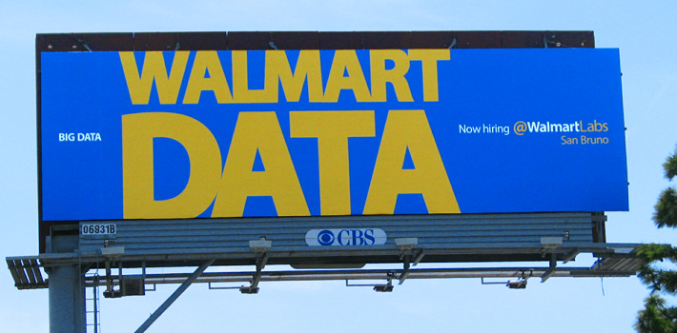
Big Data….Good, Bad, or Just Inevitable?
Notes:
Example: Wal-Mart is able to take data from your past buying patterns, their internal stock information, your mobile phone location data, social media as well as external weather information and analyze all of this in seconds so it can send you a voucher for a BBQ cleaner to your phone…….but only if you own a barbeque, the weather is nice and you currently are within a 3 miles radius of a Wal-Mart store that has the BBQ cleaner in stock.
5

Slide 6
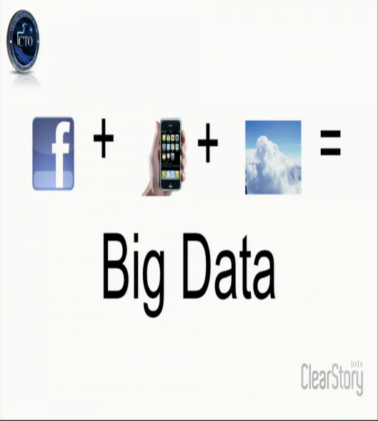
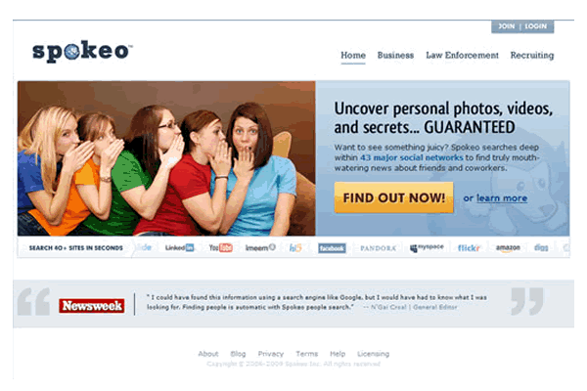
Big Data is Everywhere
Notes:
Now, smartphones know everything — where people go, what they search for, what they buy, what they do for fun and when they go to bed. If you research a Hawaiian vacation on your work desktop, you could see a Hawaii ad that night on your personal cellphone. So if someone regularly checks a news app on a phone in bed each morning, browses the same news site from a laptop in the kitchen, visits from that laptop at an office an hour later and returns that night on a tablet in the same home, Drawbridge concludes that those devices belong to the same person. And if that person shopped for airplane tickets at work, Drawbridge could show that person an airline ad on the tablet that evening.
6

