Slide 1

Aligning Forces for Quality
Leveraging Patient and Family Advisors to Interpret and Act On Patient Experience Survey Results
April 24, 2014

Slide 2
Capturing Patient Experience of Care
Carla Zema, PhD
Dale Shaller, MA
April 24, 2014

Slide 3
Capturing Patient Experience
Why does patient experience matter?
Ways of measuring patient experience
Overview of CAHPS
Intersection of patient experience surveying and patient advisors

Slide 4
IOM’s 6 Aims for Improvement
Safety
Effectiveness
Patient-Centeredness
Timeliness
Efficiency
Equity
Institute of Medicine. Crossing the Quality Chasm. Washington, DC: National Academy Press: 2001.

Slide 5
IOM Definition
“Health care that establishes a partnership among practitioners, patients, and their families…to ensure that decisions respect patients’ wants, needs, and preferences and that patients have the education and support they need to make decisions and participate in their own care.”
Institute of Medicine. Envisioning the National Health Care Quality Report. Washington, DC: National Academy Press: 2001.

Slide 6
Patient-centered care is strongly correlated with other key outcomes
Health Outcomes:
  Patient adherence
  Process of care measures
  Clinical outcomes
Business Outcomes:
  Patient loyalty
  Malpractice risk
  Employee satisfaction
  Financial performance
Browne K, Roseman D, Shaller D, Edgman-Levitan S. “Measuring Patient Experience As a Strategy for Improving Primary Care”, Health Affairs, May 2010 (29)5, 921-925.

Slide 7
Approaches to measurement
Standardized patient experience surveys
  CAHPS surveys
Patient and family advisors
  Advisory Councils
  Patient Partners
Qualitative data
  Comment cards
  Targeted rapid cycle surveys
  Focus groups and structured interviews
  Walkthroughs and shadowing

Slide 8
Capturing the Patient Perspective
Patient Experience Survey
Patient Advisors
Qualitative Data

Slide 9
Advantages of multiple methods
Patient experience surveys
Individual patient feedback
Informs quality improvement
Represents patient perspective
Representative of practice
Great for dashboard
Less “emotional”
“N of 1”
Helps to drill down
More personal

Slide 10
CAHPS Program
CAHPS = Consumer Assessment of Healthcare Providers and Systems
Most widely used survey tools for assessing the patient’s experience with care
Endorsed by National Quality Forum
Initiated and funded by AHRQ since 1995
Consortium members include: AHRQ, CMS, RAND, Yale/Harvard, and Westat

Slide 11
CAHPS Family of Surveys
Ambulatory Care Surveys
  CAHPS Clinician & Group Survey (CG-CAHPS)
  CAHPS Health Plan Survey
  CAHPS Surgical Care Survey
  CAHPS Home Health Care Survey
  CAHPS Dental Plan Survey
  ECHO (behavioral health)
Facility Surveys
  CAHPS Hospital Survey (HCAHPS)
  CAHPS In-Center Hemodialysis Survey
  CAHPS Nursing Home Survey

Slide 12
Core CAHPS Design Principles
Focus on topics for which consumers are the best or only source of information
Include patient reports and ratings of experiences – not “satisfaction”
Base question items and survey protocols on rigorous scientific development and testing, as well as extensive stakeholder input
All surveys and services are in the public domain

Slide 13
CAHPS Clinician & Group Survey
Multiple versions to meet user needs
  Visit version
  12-month version
  Patient-centered medical home (PCMH) version
  Adult and child versions
Core questions are the same across versions
Supplemental questions can be added for specific topics

Slide 14
CG-CAHPS Core Survey Composites
Access: Getting Appointments and Health Care When Needed
  Getting appointments for urgent care
Getting appointments for routine care
Getting an answer to a medical question during regular office hours
Getting an answer to a medical question after regular office hours
Wait time for appointment to start
Global Rating of Provider
0-10 rating
How Well Providers (Doctors) Communicate
Provider explanations easy to understand
Provider listens carefully
Provider gives easy to understand information
Provider knows important information about medical history
Provider shows respect for what you have to say
Provider spends enough time with you
Courteous and Helpful Office Staff
Clerks and receptionists were helpful
Clerks and receptionists treat you with courtesy and respect
14

Slide 15
External drivers of CG-CAHPS
Aligning Forces for Quality (AF4Q)
CMS ACO and PQRS
Medicare Physician Compare
NQF Measures Application Partnership
  Recommends use of CG-CAHPS for all Federal measurement/reporting/payment programs
State mandates and initiatives
Patient-Centered Medical Home initiatives

Slide 16
Use of CAHPS: best practices
Creating a patient-centered practice culture
Ongoing surveying
Continual reporting and feedback to providers and staff
  Engaging all providers and staff
Informing QI efforts
Getting input from patients
  Sharing results with patient advisors/partners
  Integrating patient feedback in QI

Slide 17
Experience from the trenches
Four Seasons Family Practice
  Located in central Maine
  MaineGeneral Medical Center
Speakers:
  Stephanie Calkins, MD; Director of Clinical Medicine
  Jodi Heath, Administrative Coordinator
  Bill Millis, Patient Advisory Council member
  Dan Spofford, Patient Experience Specialist

Slide 18
Patient Experience at Four Seasons Family Practice
A practice of Maine Dartmouth Family Practice Residency,
and MaineGeneral Medical Center
April 24, 2014

Slide 19

Who We Are
Four Seasons Family Practice
  Located in central Maine
  4 doctors, 1 PA, 1 NP
  A practice of MaineDartmouth Family Practice Residency, with affiliation with Dartmouth Medical School
MaineGeneral Medical Center (192 Beds)
  ~ 4000 Employees
  MaineGeneral Health’s mission is to enhance,
  every day, the health of the people in the greater
  Kennebec Valley.

Slide 20
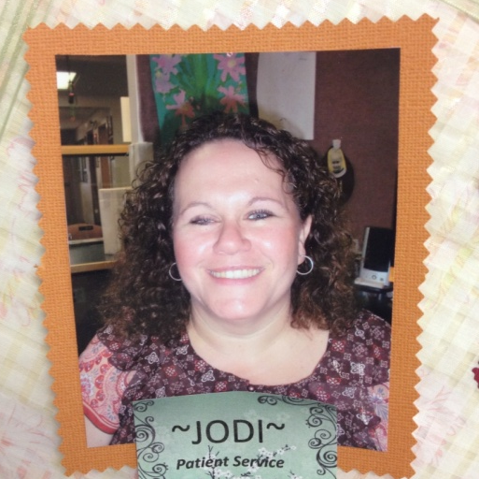
Who We Are
Participating today:
Stephanie Calkins, MD, Director of Clinical Medicine
Jodi Heath, Administrative Coordinator
Bill Millis, Patient Advisory Council member
Dan Spofford, MPA, RDLD, Patient Experience Specialist
Jayme White, Practice Administrator, FSFP
Nancy Weingarten, Administrative Director, MDFPR
Lisa Simm, Administrative Director, Quality and Safety, MGMC

Slide 21
How We Engage Patients
Patient Experience Surveys
Patient Rounding
Patient Advisory Council
Patients as Part of our Practice

Slide 22
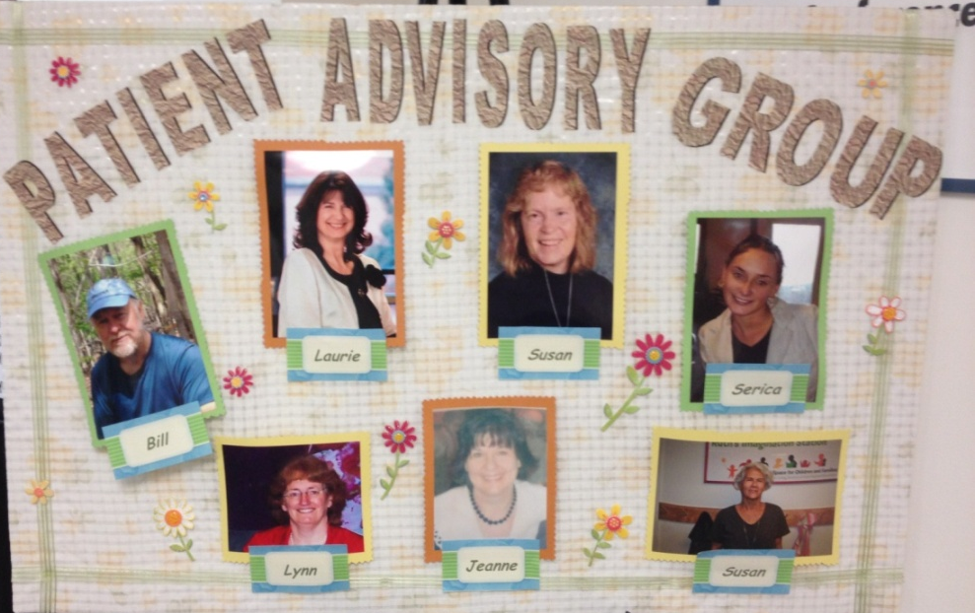
A Little Bit About Our Patient Advisory Council
Diverse representation
Meet every other month
Bulletin board in practice
Staff liaison regularly reports on council activities at our monthly staff meetings
When we have more robust website, will post
  a section here
Notes:
Comment on how staff try to make sure we have complete at least one action item before next meeting.

Slide 23
Meeting Agendas: Be Creative!
Medication reconciliation project
No Show policy
Patient experience with our Patient Experience Specialist
Community Care Team
Telephone Tree
Open House
Blue Folder project
Patient Education Room
Resident and Student involvement
Introduction to PCMH
Review of PCMH survey results of practice
What is quality work?
IT
Open Access
Group Visits
Personal Wellness Program
Introduction of staff and roles
Setting up charter

Slide 24
Engaging Patients With Survey Results
Regular topic in patient advisory council meetings
Source of agenda items for patient advisory council meetings
Patient Experience Specialist as guest at meetings
Public display of results in the practice

Slide 25
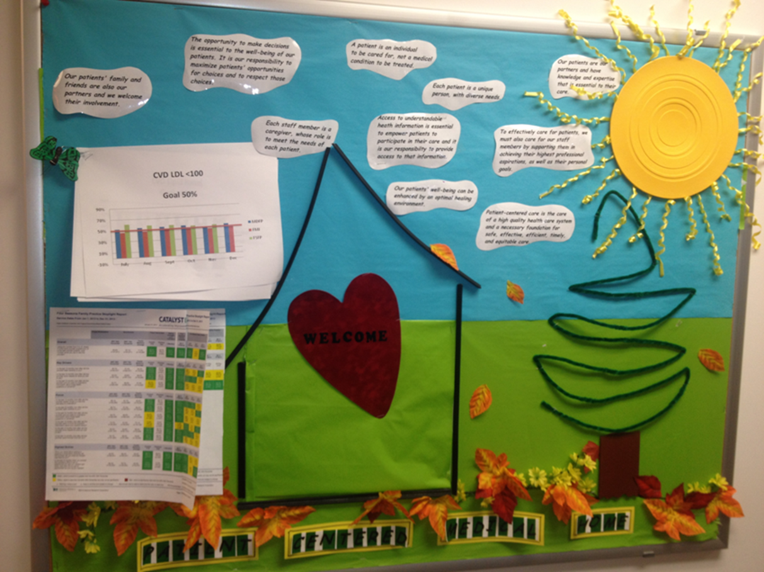

Slide 26
Patient Experience Surveys
35 Practices
  8 PCMH-Adult (CAHPS PCMH Adult survey)
  2 PCMH-Pediatric (CAHPS PCMH Child survey)
  25 Specialties (CG-CAHPS 12-Month survey;
    Change to 6-Month survey)
Patient Experience Specialist:
  Survey administration and training,
  Best practice tools and training,
  Quarterly synopsis of all results for Quality Specialist,
  Goal setting

Slide 27
CG-CAHPS Survey Sampling
145 providers
  100 completed surveys per provider per year
  Roll-up practice and system levels
Recent changes in AHRQ practice level sampling
  Move to 50 completed surveys per provider per year

Slide 28
CG-CAHPS Surveys
Returns for 5 FSFP providers is 330 for 10-1/2 months
Results for April 2013 to Feb 2014 (as of Apr 14)
Our initial goal is to meet or exceed the 50th percentile
Nationwide
Composite | Goal (%) | Result (%)
Provider rating 9-10 | 81 | 82
Provider Communication | 85 | 86
Access: Timely care and appts | 63 | 64
Office Staff | 81 | 87

Slide 29
Reporting CG-CAHPS Survey Results
Results are available to medical directors and practice
  Administrators real time through our vendor software
Results and comments are provided to Administrators
  Monthly
Results are provided to providers quarterly (changing
  to monthly in July 2014).

Slide 30
How to Engage Staff and Physicians in
Patient Experience Surveys
  Posted publicly in the practice.
  Personal comments get to the doctors and
    the whole office
  Summaries presented and discussed at monthly
    office meetings
  Results are part of provider annual evaluations

Slide 31
How to Build a Patient Centered Culture
Practice Retreats are focused on how all members of the practice influence patient experience: focus on empathy, peer coaching, goal setting, life transformation, practice transformation, respect, team building
“It’s a Dogs Life”, “World Class Service”,
  “Studer Partnership”
You need a staff liaison!
  Strong supporter of patient-and family-centered care.
  Always alert for opportunities to introduce patient-
    and family-centered concepts or to integrate them
    in new or ongoing initiatives.

Slide 32
Other Ways We Engage Patients and Families
Patient rounds: follow up phones calls on a sample each week
Retreat attendees
Site visit team members
Include in interviews
Professional-in-training for staff, providers, learners
PCMH Transformation initiatives
Focus groups
Committees/projects
  Patient Education
  Open House
  Waiting Room
  Clinic Flow
  Patient Safety
  Quality Improvement Endeavors
  Facility Design

Slide 33
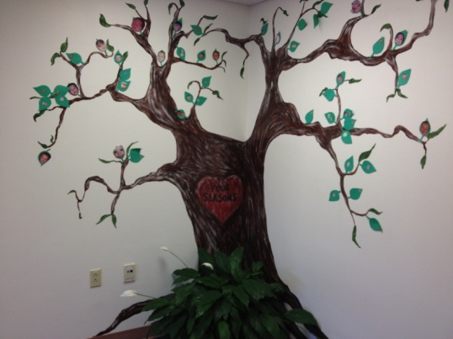
Values and Challenges
Patient perspective
Organization perspective
Physician perspective
Notes:
Translating technical data into the
voice of the patient

Slide 34
Feedback from our patients:
The leaders are committed to an open and honest
  dialogue. I feel that someone clearly puts effort into
  bringing topics to the group where the group might
  make a difference. There is buy in, we do not feel
  that we are talking for nothing, but that our input
  is open and honest and very much heard. It is
  valuable to hear perspective of others as well.

Slide 35
Feedback from our patients:
I have attended several PCMH conferences and
  have learned a great deal. This is part of my belief
  that patients need to be actively involved in their
  own health care as well as that of the community.

Slide 36
Feedback from our patients:
What was helpful to me in recruiting was the
  personal contact by Jodi asking me and
  conveying that I could make a contribution to
  services provided by Four Seasons.

Slide 37
Feedback from our patients:
The meals provided during the meeting has been
  a simple, yet effective way of providing some glue
  for the group. This has allowed the meeting to be
  less formal and to encourage attendance. I hope
  that new blood continues to be introduced to the
  group and that there is rotation out after a period
  of time. No matter how important some member
  may seem, it is crucial that we prevent an old guard
  from developing who have served forever. Term limits
  of some sort are important for the vitality of the PAG.

Slide 38
I joined and continue because I am personally very
  interested in improving the delivery of health care to my
  family as well as to my community. The PAG gives me
  a real mechanism to make my thoughts known and to
  provide the professionals with a perspective that was
  frequently ignored in the past. I have a sense that there
  exists a real partnership at Four Seasons and that the
  PAG is truly valued. Little things like Dr. Minnie's
  frequent attendance convey the impression that what we
  have to contribute is really valued. Dr. Minnie says that
  she comes because of the food, but I know the real reason
  is that she wants to hear from consumers what is
  important and that the PAG offers the opportunity
  for a dialogue.
Feedback from our patients:

Slide 39
Feedback from our patients:
The phone call from Jodi provided a personal touch.
  She was articulate in telling me about the group, how it
  was formed and how they functioned within the practice.
  I was already aware that a patient advisory group
  existed as I had seen the poster displayed in the office
  so having further explanation was helpful. She also
  indicated that individuals within the practice felt that
  I might be a good fit for the group. Knowing that the
  practice was being thoughtful in inviting participants,
  led me to believe that this was just not an 'exercise' to
  meet a practice goal, but something that was thought
  about and planned for.

Slide 40
Feedback from our patients:
Having been a patient of the practice for many years,
  I can attest to the fact that all members of the practice
  team are committed to patient care and service. I had
  already experienced the concern and 'customer service'
  approach that makes me want to stay with my current
  physician. It is this human approach that trickles down
  and will keep the group viable. The group will be
  sustained by continuing to validate its members through
  seeking input and keeping them actively and regularly
  involved in issues that affect the practice and
  patient services.

Slide 41
Feedback from our patients:
I recently retired from the long term care arena and
  have a continuing interest in health care. I also enjoy
  being part of a group that identifies and tackles issues,
  sets goals and energizes its members. Agendas that are
  meaningful will be important as the group moves
  forward-- and for me, I need to feel that
  I bring value to the table.

Slide 42
Feedback from our patients:
Continue actively recruiting people and phase them
  in as they are interested in starting.
Having guest speakers coming in is a great way to
  inject some new ideas and approaches. If they are
  coming to us from other practices that have
  advisory groups and share what works for them, that
  would be helpful in generating some change.

Slide 43
Feedback from our patients:
Being valued and listened to is important to
  any group member. At my first meeting it was
  obvious that this group was highly thought of and
  appreciated. I was also pleased to see that one
  of the practice physicians was involved. She was
  obviously interested in what we had to say and
  skillfully integrated herself into the conversation.
  I also learned that one of the group members was part
  of the interview team for the hiring of a new physician.
  This further validated for me the importance that the
  practice placed upon patient input.

Slide 44



Building Partnerships to Improve Patient and Family Experience of Care
Mary Minniti, CPHQ
April 24, 2014
A Road Map
44

Slide 45


Individuals responsible for patient experience and/or organizational dashboards need to create opportunities to involve patients and families in their work.
45
Notes:
Title (No Line Under), Bulleted List (Tab in bullet to go to lower bullet level.)

Slide 46
Useful Framework for Participation
Depth of Engagement | Patients and Family Role | Things to Consider
Ad Hoc Input | Survey or Focus Group Participants | Ensure diversity and representation, validity
Structured Consultation | Council or Advisors- provide input | Early consult supports partnership model
Influence | Occasional Review/Consultants to project | Allows flexible ways to participate; requires background/orient.
Negotiation | Member of QI Group | Training in QI approach
Delegation | Co-Chair of QI Group | High level of expertise or skill
Advisor Control | Implementer or peer support role | Strong training component, mentoring and compensation
46

Slide 47
No Formal Advisors: Start Here
See Got Advisors for Next Steps
Create Formal Advisory Structures
Utilize resources to build more formal ways to receive ongoing input/participation
Listen, Listen, Listen
Ask Questions for Understanding and Ideas for Improvement
Identify Informal Ways to Solicit Input
Keep It Simple and Easy for Patients/Families
47

Slide 48
Examples from other clinics
Meet with recent “critical thinkers”, review CAHPS questions and gain their insight about what strongly agree would look like for them
Use interview or post card format to gather responses to these questions:
  Please share one positive example from your recent office visit.
  Please share one example that could have been improved.
  If you could make one change in your experience of care, what would it be?
Convene focus group to share results in a “opportunity area” and ask for their perspective about the whats and whys
Consider an exit survey for those leaving your practice
48

Slide 49
Got Advisors: Start Here
Monitor Changes - Results
Implement Ideas
Create Potential Solutions
Collaboratively Identify Opportunities
Listen, Listen, Listen
Ask Questions for Understanding
Prepare Advisors to Contribute
49

Slide 50
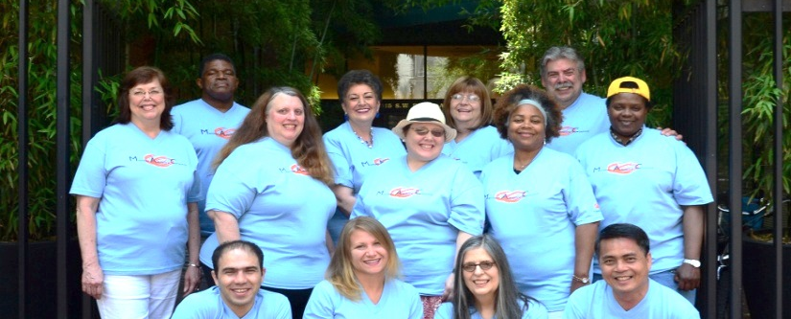
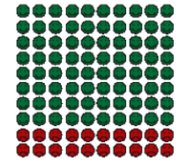
Preparing Advisors for
Meaningful Participation in CAHPS
Orient advisors to the survey questions, methodology & current results
Give ample time for their review & Q’s
De-mystify percentiles
percentages using pictographs
or other symbols
Share how results are used in
clinic and with whom
What do they think contributes
to responses at either end
50

Slide 51
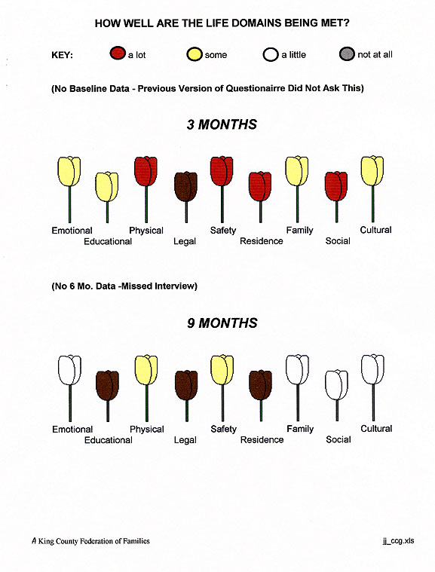
King County Blended Funding Project, Vander Stoep et al, The Journal of Behavioral Health Services & Research, 1999.
51

Slide 52
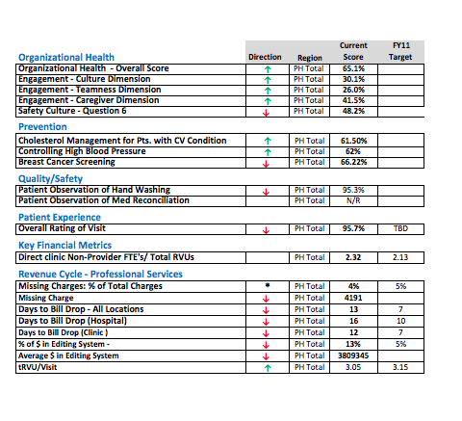
Dashboards: Are They Patient- or Family-Centered?
What Do Advisors Believe Executives Should Track in CAHPS?
“What gets measured gets done.
What gets measured and fed back
gets done well.
What gets rewarded gets repeated.”
Jones & Bearley, 1996

Slide 53

Give patient and family advisors time to help you understand what “it” means to them
53

Slide 54

Meaningful Involvement of
Patients and Families
Best Practice
Provide some background on topic and questions for advisors to think about prior to meeting.
Be sincere; ask for input only if you are committed to change based on feedback provided.
Encourage and appreciate any and all questions, especially ones that ask for clarification.
Choose activities that value patient and family perspective and are important to both the advisor and the organization.
Prepare staff and clinicians for working with patients and families in this new way. Address concerns and
Demonstrate how the input made a difference in the outcome or product developed. A thank-you goes far!
54

Slide 55
Measuring Collaboration
55
Source: Mid Valley Behavioral Care Network Salem, Oregon

Slide 56
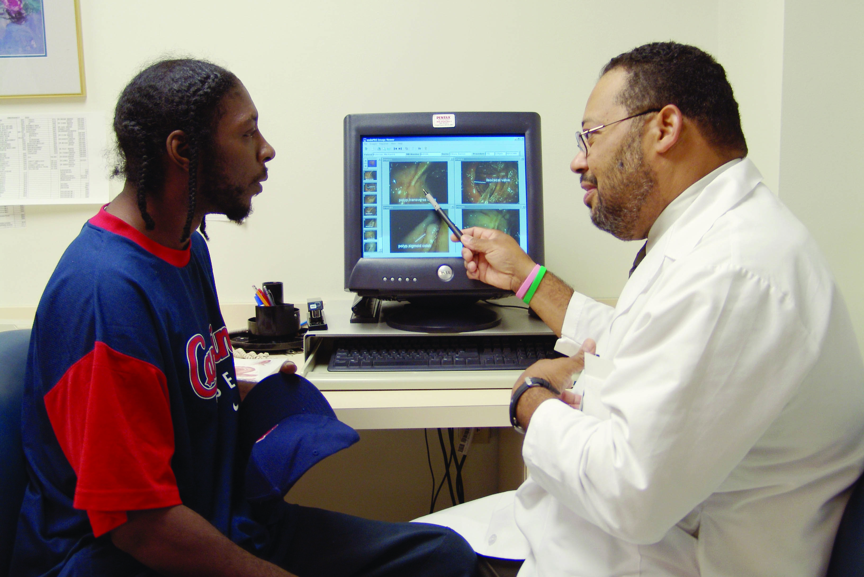
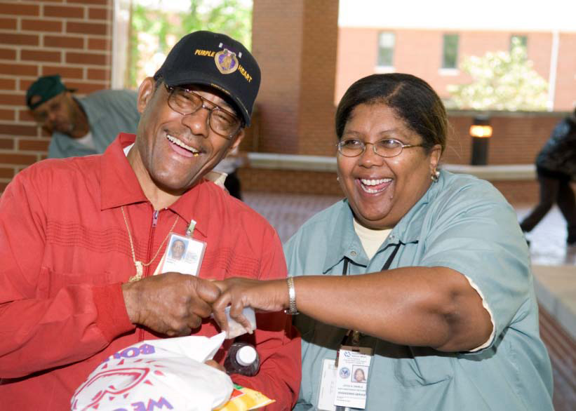
Patient- and family-centered care is working "with" patients and families, rather than just doing "to" or "for" them.
56

Slide 57


To do this work, you have to take a leap of faith. All you need is to be clear on what you are trying to do in the first place. You can make it difficult or just realize how simple this can be.” Katie Boston

Slide 58

What will
you do
to create
meaningful
Partnerships
to improve the
experience of
care?
58
Notes:
Questions to ask?
Reflective winding waters clinic…..

Slide 59
Resources
A Tale of Three Practices: How Medical Groups Are Improving the Patient Experience
http://forces4quality.org/tale-three-practices-how-medical-groups-are-improving-patient-experience
Patient Experience of Care: Inventory of Improvement Resources
http://forces4quality.org/patient-experience-care-inventory-improvement-resources-0
CAHPS Improvement Guide
https://cahps.ahrq.gov/quality-improvement/improvement-guide/improvement-guide.html
Patient Engagement Toolkit
http://forces4quality.org/compendium-tools-engaging-patients-your-practice
Patient-Centered Primary Care Institute site
http://www.pcpci.org/search?search_api_views_fulltext=CAHPS+Surveys
Measuring and Improving the Patient Experience of Care: Surveys, Tools, and Approaches
http://www.pcpci.org/resources/webinars/measuring-and-improving-patient-experience-care-surveys-tools-and-approaches
Preparing for Collaborative Work with Patient and Family Advisors
http://www.pcpci.org/resources/webinars/preparing-collaborative-work-patient-and-family-advisors
Free downloadable materials and webinars
www.ipfcc.org
Patient and Family Advisory Network:
Connect with others working in clinics and hospitals on CAHPS
http://pfacnetwork.ipfcc.org

Slide 60
Questions?
Webinar recording and slides are available online at www.forces4quality.org

